Slide 1
Coupa Supplier Portal (CSP) Training

Slide 2
02
CSP Registration for Suppliers Without a CSP Account

Slide 3

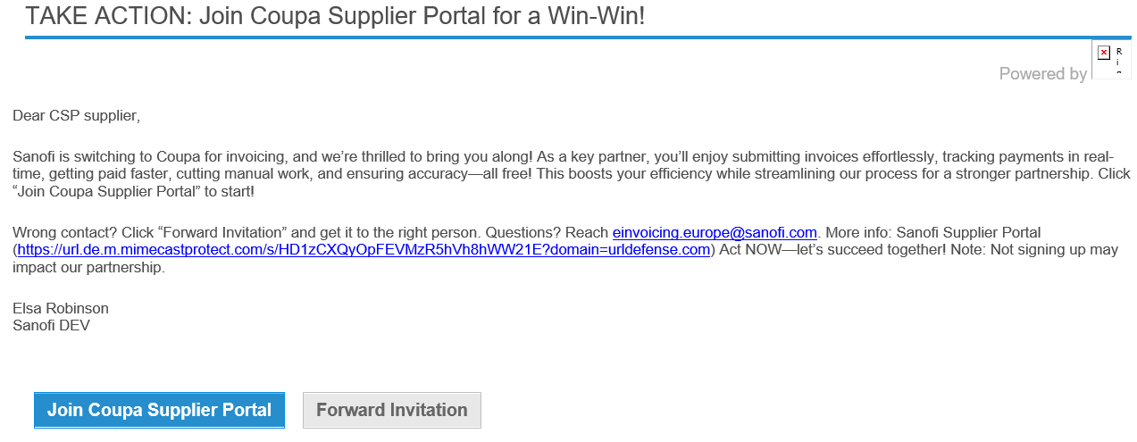
Receive Invitation Email
Complete CSP registration & Accept Terms and Conditions
Complete profile
Ready to receive PO & issue Invoice via CSP
EXAMPLE
Registration Process: Suppliers Without a CSP Account (1/8)
1
Registration Process: Suppliers Without a CSP Account (1/8)
If you do not currently have a Coupa Supplier Portal (CSP) account, you will receive an invite from Sanofi via email*
Click the “Join Coupa Supplier Portal” button in the email, after this you will be directed to the CSP website where you will be required to input your credentials to complete your CSP registration
If you are not the correct recipient for the invitation, click on the “Forward Invitation Button” to forward the invitation to the correct person within your business
2
3
*Note: this email will come from a Do-not-reply Coupa email box and not the Sanofi supplier enablement email address.

Slide 4
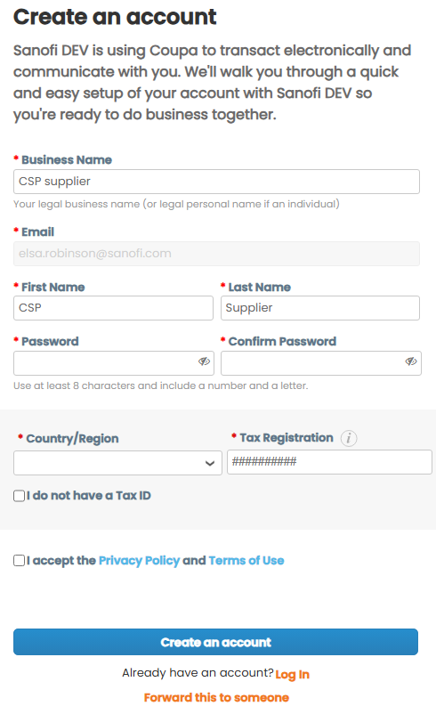
Receive Invitation Email
Complete CSP registration & Accept Terms and Conditions
Complete profile
Ready to receive PO & issue Invoice via CSP
EXAMPLE
Registration Process: Suppliers Without a CSP Account (2/8)
Registration Process: Suppliers Without a CSP Account (2/8)
Input your “Business name” and create a “Password”*
Input your companies “Country/ Region” and “Tax Registration” if you do not have a Tax ID check the “I do not have a Tax ID” tick box
As a new Coupa user, you will also be asked to “accept the Privacy Policy and the Terms of Use” – please access via the hyperlinks and read and confirm accordingly
Click on the “Create an Account” button, which will direct you to a new page for email verification
4
5
6
*Note: The “Email”, “First Name” and “Last Name” fields will prepopulate based on the information provided by Sanofi, however, you are able to edit the Business, First and Last Name fields if required.
7

Slide 5
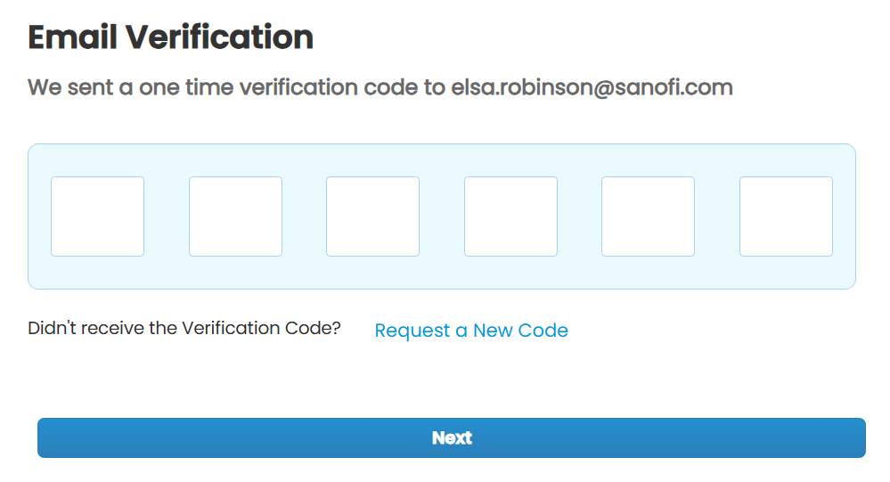
Receive Invitation Email
Complete CSP registration & Accept Terms and Conditions
Complete profile
Ready to receive PO & issue Invoice via CSP
EXAMPLE
Registration Process: Suppliers Without a CSP Account (3/8)
Registration Process: Suppliers Without a CSP Account (3/8)
Input the Verification Code that you will have received via email
Click on the “Next” button*
8
9
*Note: You will be directed to the Coupa Supplier Portal, where you will be required to complete (1) the legal entity and (2) the remit-to account setup.

Slide 6
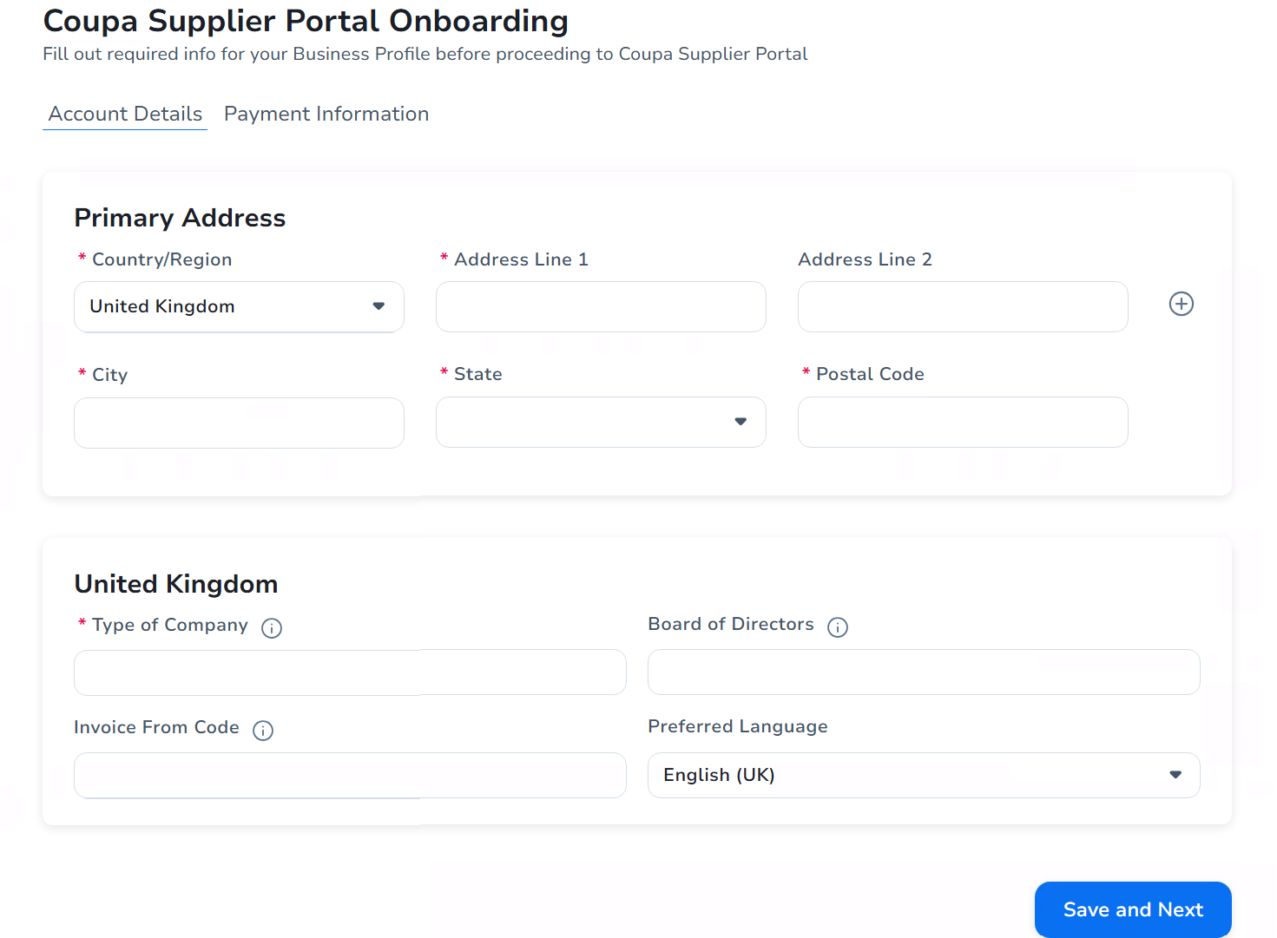
Receive Invitation Email
Complete CSP registration & Accept Terms and Conditions
Complete profile
Ready to receive PO & issue Invoice via CSP
EXAMPLE
Registration Process: Suppliers Without a CSP Account (4/8)
Registration Process: Suppliers Without a CSP Account (4/8)
As you are accessing the CSP for the first time, a pop-up window will display for you to complete your CSP profile setup.*
On the Coupa Supplier Portal Onboarding page, you will need to complete the “Account Details” section first:
Complete all the required fields to set up your “Primary Address” and other invoice-from details
“Invoice From Code” field should not be blank for suppliers who have agreed to enable cXML as the invoice transmission channel
Once you have completed this section, click on the “Save and Next” button
10
*Note: As you are signing up to the CSP for the first time, you will need to provide this information before you can successfully submit an invoice.
11

Slide 7
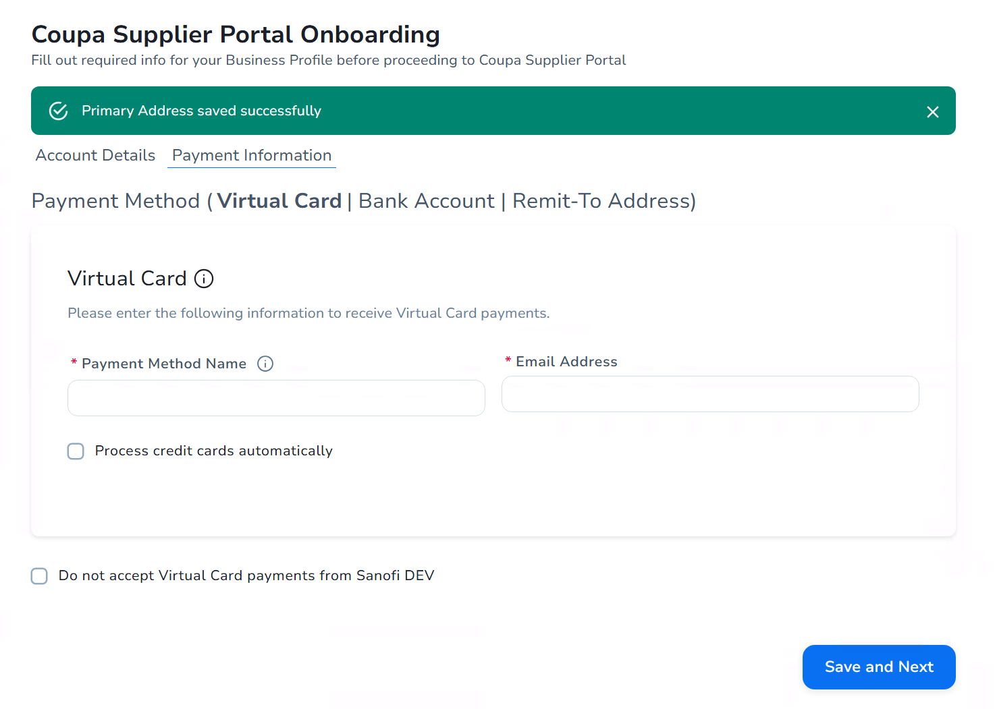
Receive Invitation Email
Complete CSP registration & Accept Terms and Conditions
Complete profile
Ready to receive PO & issue Invoice via CSP
EXAMPLE
Registration Process: Suppliers Without a CSP Account (5/8)
Registration Process: Suppliers Without a CSP Account (5/8)
After setting up your primary address (i.e. the invoice-from details), you will then need to complete the “Payment Information” section:
Complete all the required fields for “Virtual Card” payment setup
To opt out of this payment methods, select the “Do not accept Virtual Card payments from Sanofi” checkbox
Once you have completed this section, click on the “Save and Next” button
12
13

Slide 8
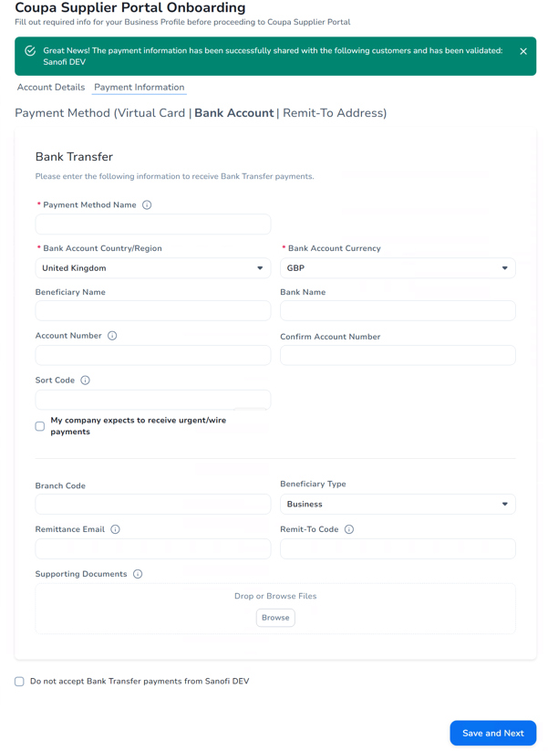
Receive Invitation Email
Complete CSP registration & Accept Terms and Conditions
Complete profile
Ready to receive PO & issue Invoice via CSP
EXAMPLE
Registration Process: Suppliers Without a CSP Account (6/8)
Registration Process: Suppliers Without a CSP Account (6/8)
After setting up your Virtual Card payments, you will need to set up your Bank Transfer payments:
Complete all the required fields for “Bank Transfer” payment setup
“Remit-To Code” field should not be blank for suppliers who have agreed to enable cXML as the invoice transmission channel
To opt out of this payment methods, select the “Do not accept Bank Transfer payments from Sanofi” checkbox
Once you have completed this section, click on the “Save and Next” button
14
15

Slide 9
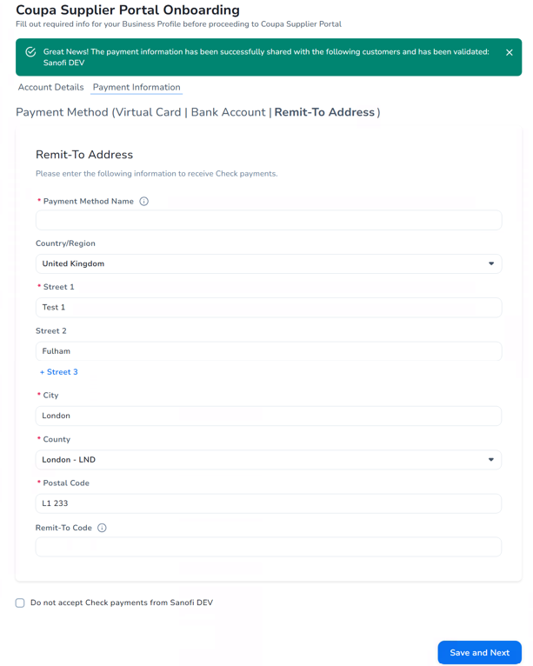
Receive Invitation Email
Complete CSP registration & Accept Terms and Conditions
Complete profile
Ready to receive PO & issue Invoice via CSP
EXAMPLE
Registration Process: Suppliers Without a CSP Account (7/8)
Registration Process: Suppliers Without a CSP Account (7/8)
After setting up your Bank Transfer payments, you will need to set up your Check payments:
Complete all the required fields for “Remit-To Adress” setup:
Most fields will be auto-populated based on the Primary Address details as you set up previously – you can edit as required
The “Remit-To Code” field should not be blank for suppliers who have agreed to enable cXML as the invoice transmission channel
To opt out of this payment methods, select the “Do not accept Check payments from Sanofi” checkbox
Once you have completed this section, click on the “Save and Next” button
16
17

Slide 10
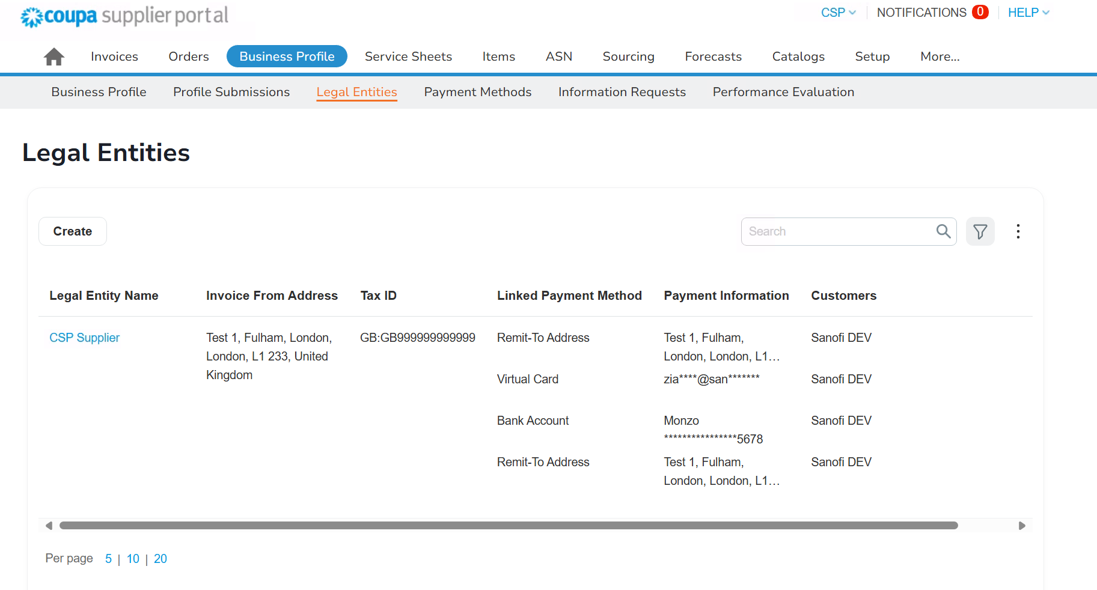
Receive Invitation Email
Complete CSP registration & Accept Terms and Conditions
Complete profile
Ready to receive PO & issue Invoice via CSP
EXAMPLE
Registration Process: Suppliers Without a CSP Account (8/8)
Registration Process: Suppliers Without a CSP Account (8/8)
After completing your CSP profile setup, you can navigate to “Business Profile” tab to view your Legal Entity and Payment Method information:
Click “Legal Entities” sub-tab to view legal entity setup details
Click “Payment Methods” sub-tab to view payment methods setup details
Now you have completed your CSP profile setup, and you are ready to receive POs and issue Invoices via CSP with Sanofi.
18
19

Slide 11
03
CSP Registration for Suppliers With an Existing CSP Account

Slide 12
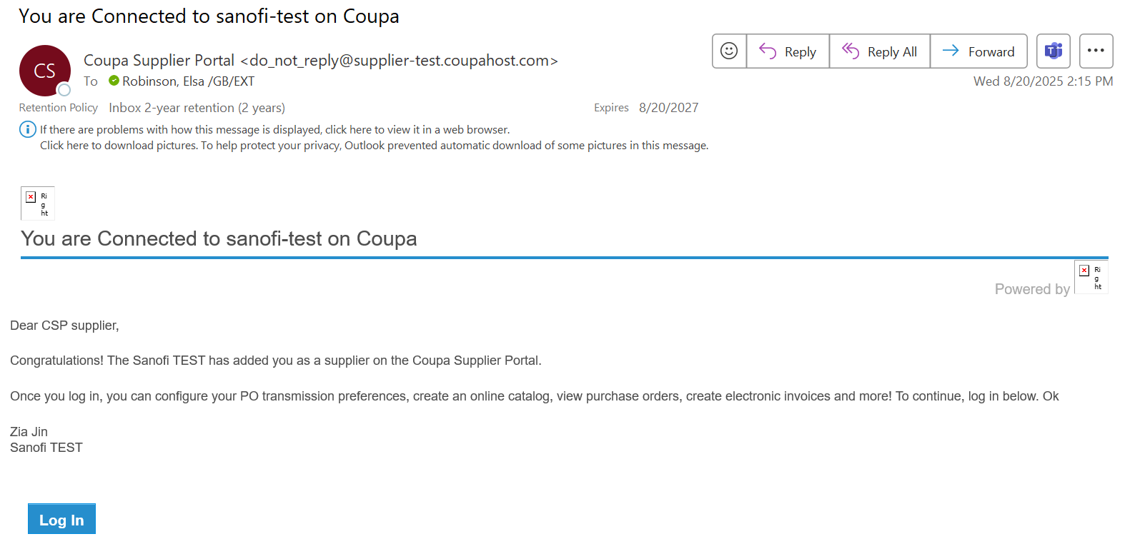
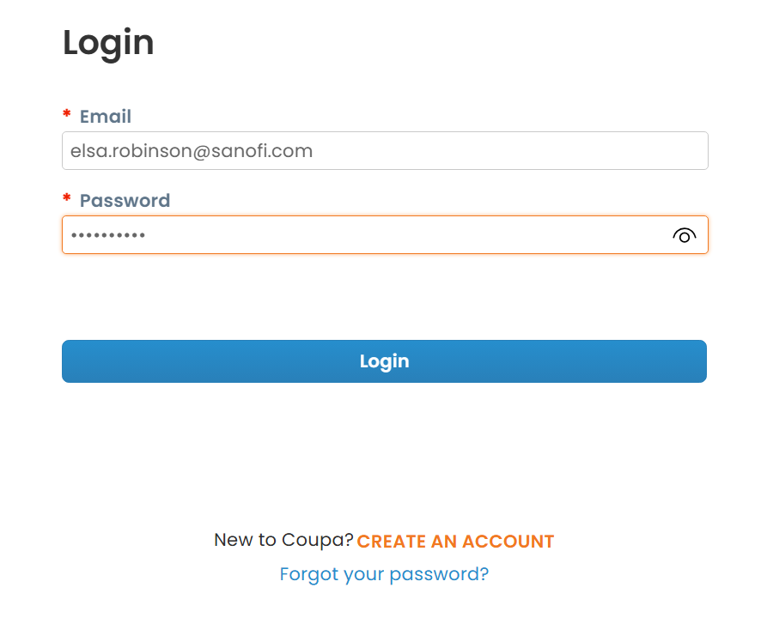
Receive invitation email
Connect to Sanofi
Ready to receive PO & issue Invoice via CSP
EXAMPLE
Registration Process: Suppliers With an Existing CSP Account (1/6)
Registration Process: Suppliers With an Existing CSP Account (1/6)
If you have an existing Coupa Supplier Portal (CSP) account you will receive a notification from Sanofi via email*, click “Login” to navigate to the Login page.
Input your “Email” and “Password” and click “Login” to access the Coupa Supplier Portal.
1
2
*Note: this email will come from a Do-not-reply Coupa email box and not the Sanofi supplier enablement email address.

Slide 13
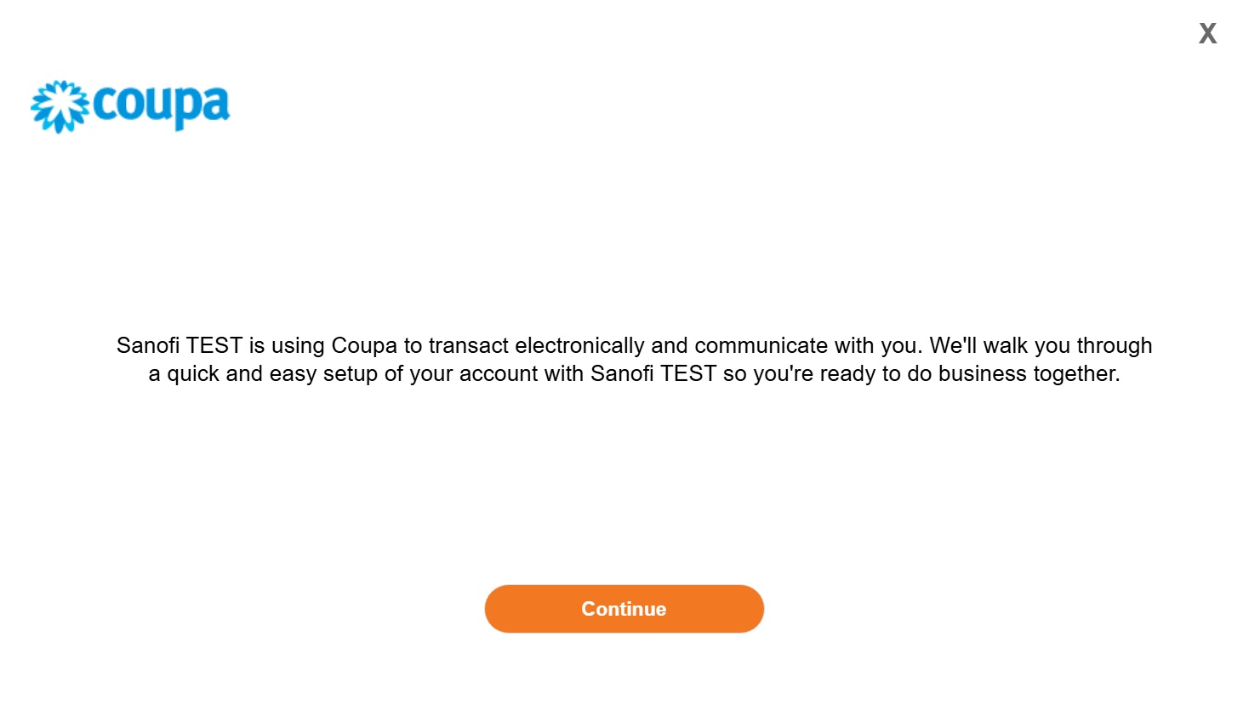
Receive invitation email
Connect to Sanofi
Ready to receive PO & issue Invoice via CSP
EXAMPLE
Registration Process: Suppliers With an Existing CSP Account (2/6)
Registration Process: Suppliers With an Existing CSP Account (2/6)
After you have logged into the CSP, you will be able to see a pop-up screen for a quick account setup:
Click the “Continue” button
You will then be taken to the Payment Methods page to set up your invoice-from, ship-from, and remit-to details with Sanofi.
3

Slide 14
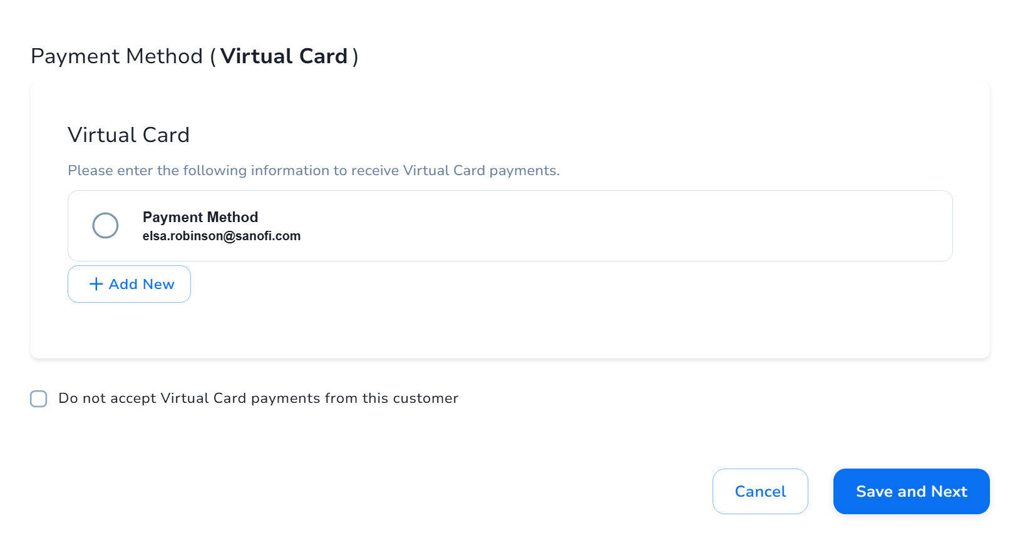
Receive invitation email
Connect to Sanofi
Ready to receive PO & issue Invoice via CSP
EXAMPLE
Registration Process: Suppliers With an Existing CSP Account (3/6)
Registration Process: Suppliers With an Existing CSP Account (3/6)
On the Payment Method (Virtual Card) page, you will be provided with options to either opt-in or opt-out of Virtual card.
To use the existing Virtual Card payment method – select the radio button of the corresponding option
To create a new Virtual Card payment method – click on the “Add New” button and populate the required fields
To opt out Virtual Card payments – select the “Do not accept Virtual Card payments from this customer” checkbox
Once you have completed this section, click on the “Save and Next” button
4
5
6
7

Slide 15
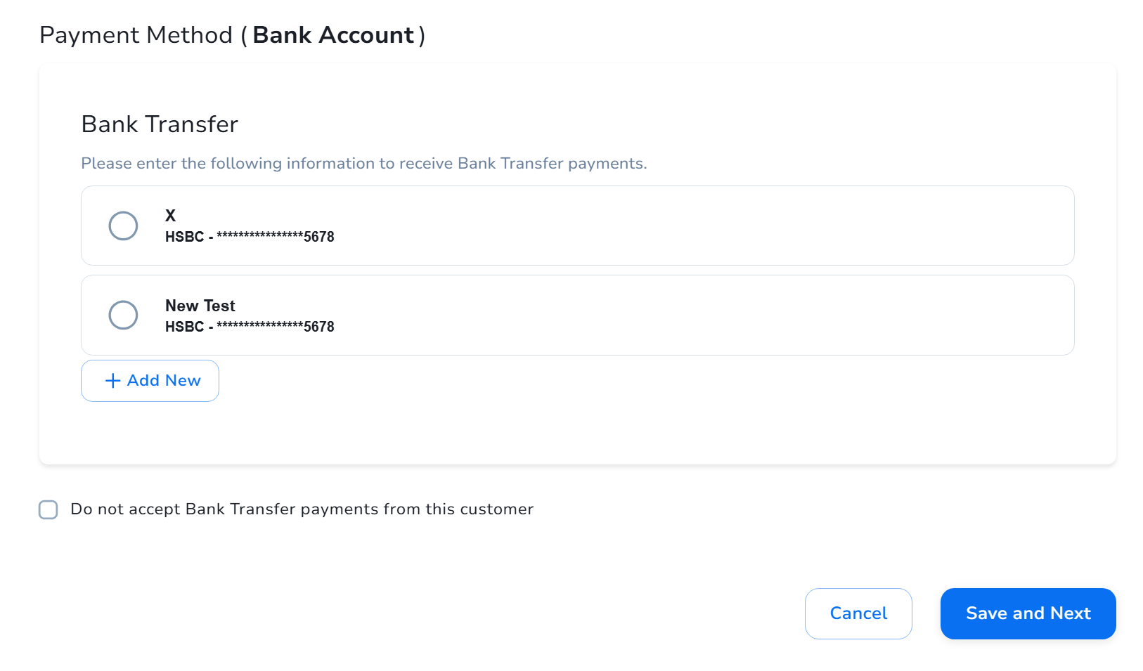
Receive invitation email
Connect to Sanofi
Ready to receive PO & issue Invoice via CSP
EXAMPLE
Registration Process: Suppliers With an Existing CSP Account (4/6)
Registration Process: Suppliers With an Existing CSP Account (4/6)
On the Payment Method (Bank Account) page, you will need to set up the Bank Transfer payment details for Sanofi:
To use the existing Bank Transfer payment method – select the corresponding radio button(s)
To create a new Bank Transfer payment method – click “Add New” button and populate the required fields
To opt out Bank Transfer payments – select the “Do not accept Bank Transfer payments from this customer” checkbox
Once you have completed this section, click on the “Save and Next” button
8
9
10
11

Slide 16
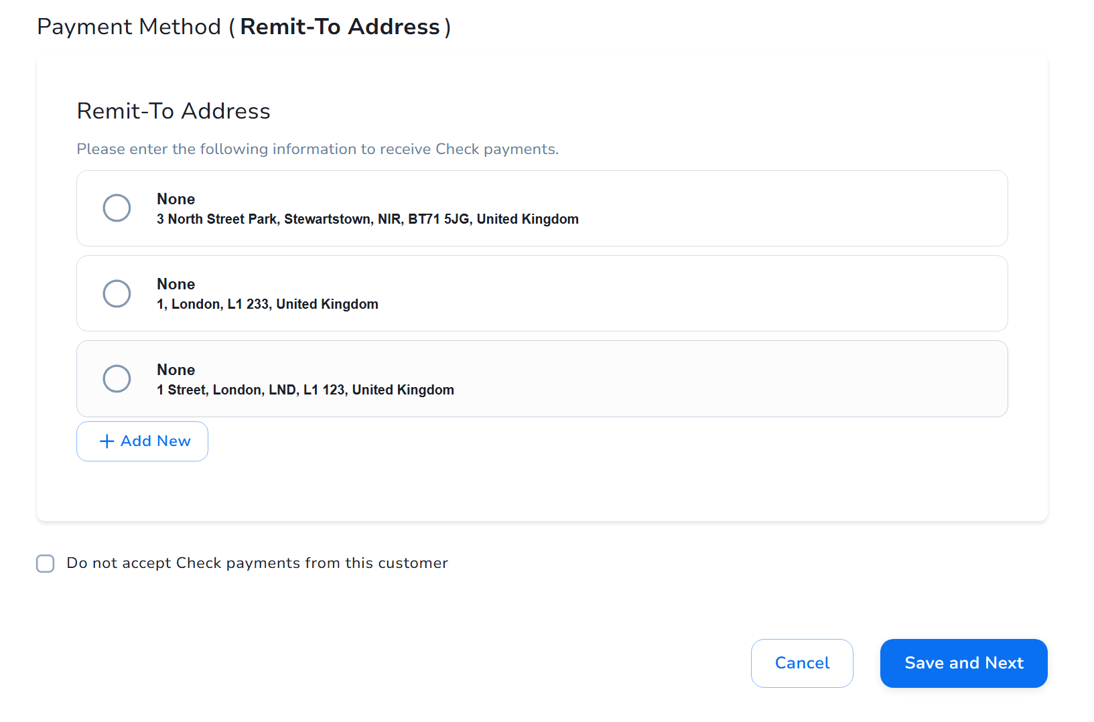
Receive invitation email
Connect to Sanofi
Ready to receive PO & issue Invoice via CSP
EXAMPLE
Registration Process: Suppliers With an Existing CSP Account (5/6)
Registration Process: Suppliers With an Existing CSP Account (5/6)
On the Payment Method (Remit-To Address) page, you will need to set up the Check payments for Sanofi:
To use the existing Check payment method(s) – select the corresponding radio button(s)
To create a new Check payment method – click “Add New” button and populate the required fields
To opt out Check payments – select the “Do not accept Check payments from this customer” checkbox
Once you have completed this section, click on the “Save and Next” button
12
13
14
15

Slide 17
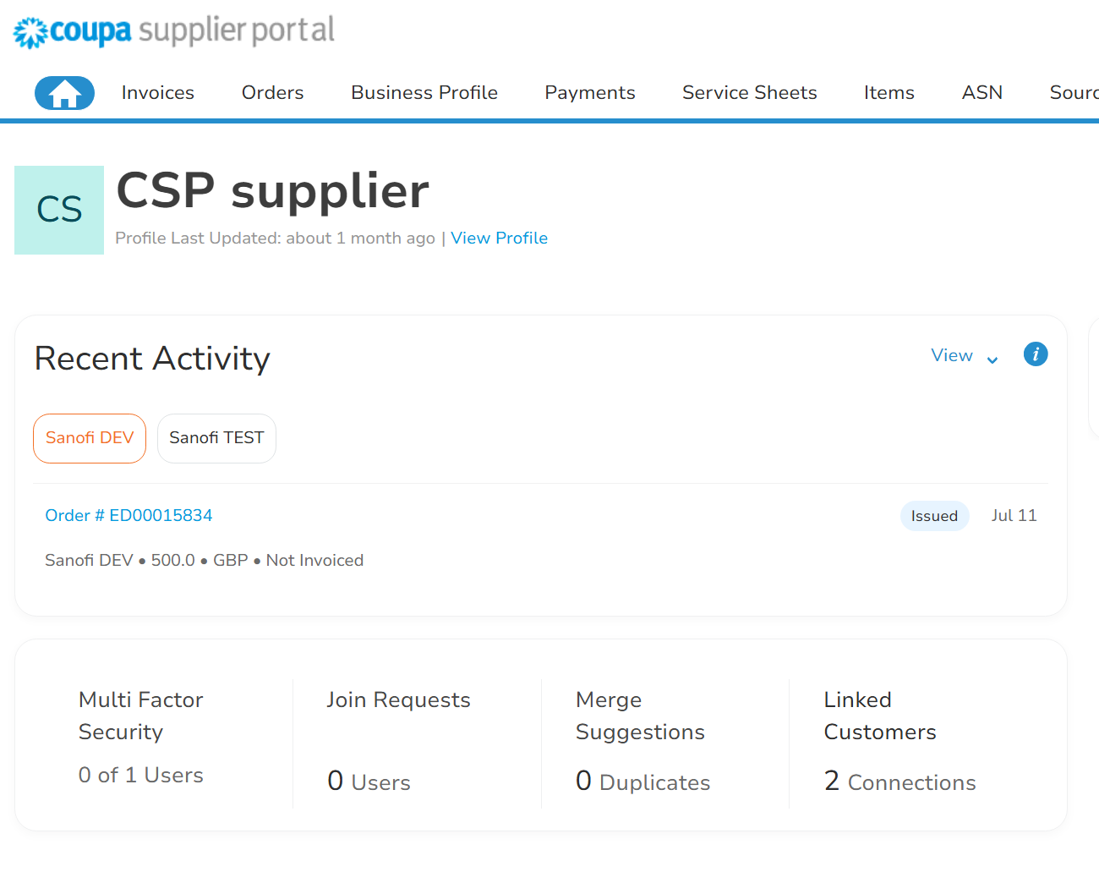
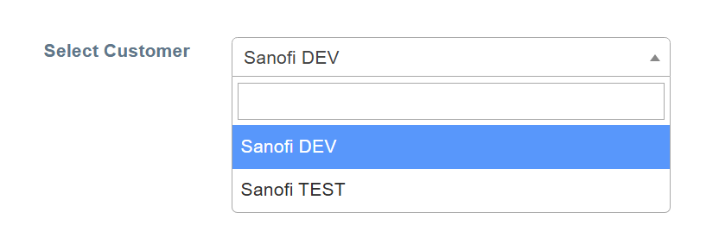
Receive invitation email
Connect to Sanofi
Ready to receive PO & issue Invoice via CSP
EXAMPLE
Registration Process: Suppliers With an Existing CSP Account (6/6)
Registration Process: Suppliers With an Existing CSP Account (6/6)
After you have completed your payment methods setup, you will be directed back to the CSP homepage, and on the CSP dashboard:
You will be able to see 1 more customer has been linked to your existing CSP account
And by navigating to other tabs, e.g. “Invoices” and “Orders”:
You will be able to see the corresponding Sanofi POs and Invoices by selecting Sanofi from the “Select Customer” dropdown list
16
17

Slide 18
04
How to Navigate Through CSP

Slide 19
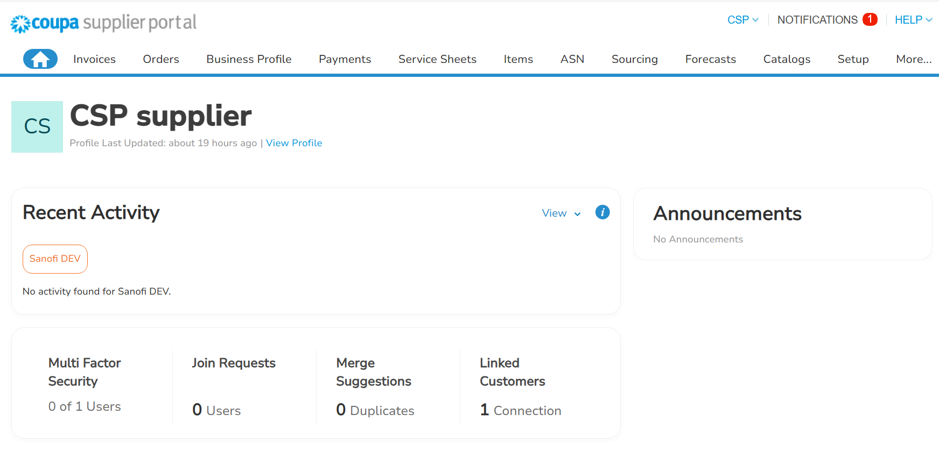
EXAMPLE
How to Navigate Through CSP (1/2)
1
2
3
4
5
6
7
How to Navigate Through CSP (1/2)
Account: Your account name with an associated drop-down sub-menu – to manage your CSP account.
Notifications: To view notifications and manage notification preferences.
Help: To access the CSP help sub-menu:
Coupa Compass: where you can find resources, such as support articles, to better use Coupa.
Training Webinars: where you can register for a supplier training webinar.
Help Tour: of the open page in question.
Home: To navigate to the CSP homepage.
Invoices: To access, manage, and create Invoices.
Orders: To access and manage Purchase Orders.
Business Profile: To manage your profile information.

Slide 20
EXAMPLE
How to Navigate Through CSP (2/2)
How to Navigate Through CSP (2/2)
Multi Factor Security: Number of users who have completed the two-factor authentication setup.
Join Requests: Requests from new users to access this account.
Merge Suggestions: Suggestions to merge multiple CSP accounts with the same confirmed email domain.
Linked Customers: Number of your trading customers on Coupa.
9
10
11
12

